Slide 2
Create 3 text box and a button with value “Add”.
On click it should do addition of 2 given value in a text box
Result should be displayed in Result textbox.
Result textbox is readonly
import {useState} from 'react'
function App() {
const[no1,setno1]=useState(0);
const[no2,setno2]=useState(0);
const[no3,setno3]=useState(0);
const add=()=>setno3(+no1 + +no2);
return (
<>
<input name="no1" value={no1} onChange={(e)=>setno1(e.target.value)}/>
<input name="no2" value={no2} onChange={(e)=>setno2(e.target.value)}/>
<button type="button" onClick={add}>add</button>
<input name="no3" value={no3} disabled={true}/>
</>
);
}
export default App;

Slide 3
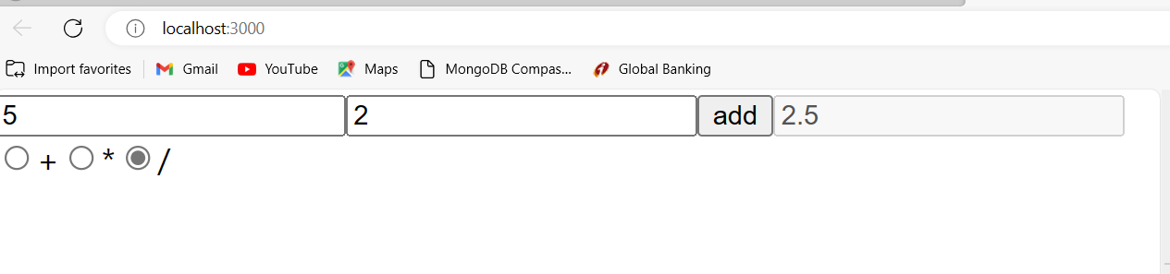
Let user checked radio button and on click of button it should perform that checked operation

Slide 4
import {useState} from 'react'
function App() {
const[no1,setno1]=useState(0);
const[no2,setno2]=useState(0);
const[no3,setno3]=useState(0);
const [rd,setrd]=useState(null);
const add=()=>{
let result=""
if(rd=='+')
result=(+no1 + +no2);
else if(rd=='*')
result=(+no1 * +no2);
else if(rd=='/')
result= +no1 / +no2;
setno3(result);
}
return (
<>
<input name="no1" value={no1} onChange= {(e)=> setno1 (e.target.value ) } />
<input name="no2" value={no2} onChange= {(e)=> setno2 (e.target.value) } />
<button type="button" onClick={add}>add</button>
<input name="no3" value={no3} disabled={true}/>
<input type='radio' name="rd" value='+' checked={rd==='+'} onChange={(e)=>setrd(e.target.value)} />+
<input type='radio' name="rd" value='*' checked={rd==='*'} onChange={(e)=>setrd(e.target.value)}/>*
<input type='radio' name="rd" value='/' checked={rd==='/'} onChange={(e)=>setrd(e.target.value)}/>/
</>
);
}
export default App;

Slide 5
import React from "react";
const App = () => {
const [allchecked, setAllChecked] = React.useState([]);
function handleChange(e) {
if (e.target.checked) {
setAllChecked([...allchecked, e.target.value]);
} else {
setAllChecked(allchecked.filter((item) => item !== e.target.value));
}
}
return (<> <div>
<input value = "One" type = "checkbox" onChange = {handleChange} /> <span> One </span>
</div>
<div>
<input value = "Two" type = "checkbox" onChange = {handleChange} /> <span> Two </span>
</div>
<div>
<input value = "Three" type = "checkbox" onChange = {handleChange} /> <span> Three </span>
</div>
<div>
<input value = "Four" type = "checkbox" onChange = {handleChange} /> <span> Four </span>
</div>
<div>
<input value = "Five" type = "checkbox" onChange = {handleChange} /> <span> Five </span>
</div>
<div>The all checked values are {allchecked.join(" , ")}</div> </div>
);
};
export default App;

Slide 6
const [allchecked, setAllChecked] = React.useState([]);
function handleChange(e) {
if (e.target.checked) {
setAllChecked([...allchecked, e.target.value]);
}
else {
setAllChecked(allchecked.filter((item) => item !== e.target.value));
}
}
1
2
3
4
U1
One
Two
Three
Four
Five
allchecked
[ 1,2,3,4 ]
This line creates a new array using the spread operator (...) to copy all current values from allchecked, and then adds e.target.value at the end.
allchecked.filter((item) => item !== e.target.value)

Slide 7
export default function TodoApp() {
const [allchecked, setAllChecked] = React.useState([]);
const hobbies = ["Reading", "Traveling", "Cooking", "Gaming"];
function handleChange(e) {
if (e.target.checked) {
setAllChecked([...allchecked, e.target.value]);
} else {
setAllChecked(allchecked.filter((item) => item !== e.target.value));
}
}
return (
<div> <h1>Hobbies</h1>
{hobbies.map((hobby) => (
<div key={hobby}>
<label>
<input
type="checkbox"
value={hobby}
onChange={handleChange}
checked={allchecked.includes(hobby)}
/>
{hobby}
</label> </div>
))}
<p>Selected Hobbies: {allchecked.join(", ")}</p>
</div>
);
}
Dynamic check box

